Slide 1
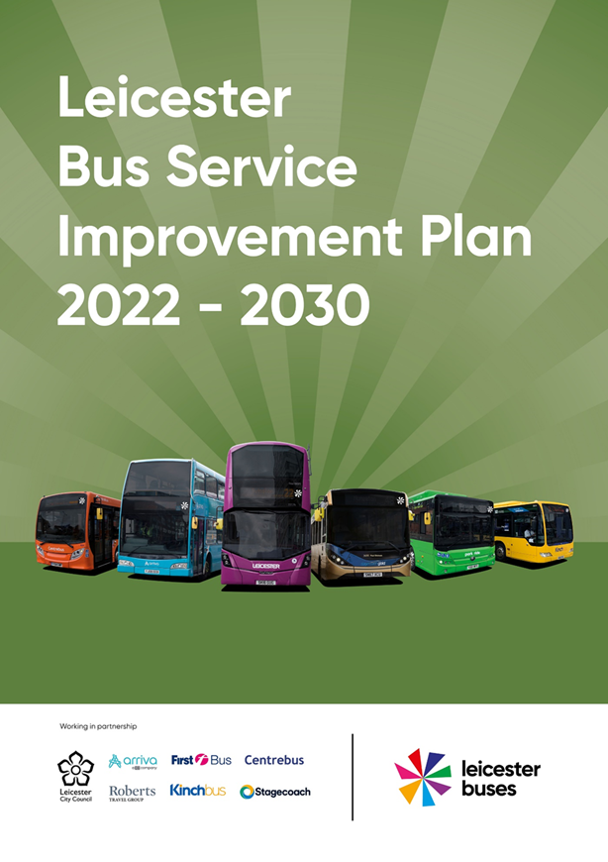
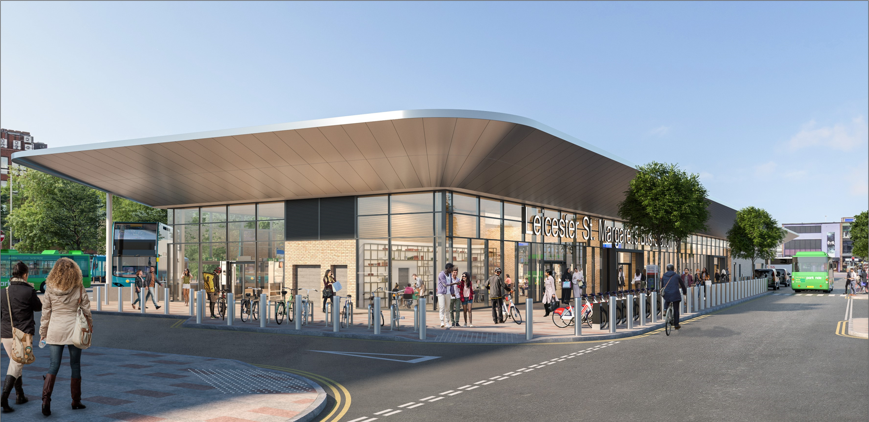
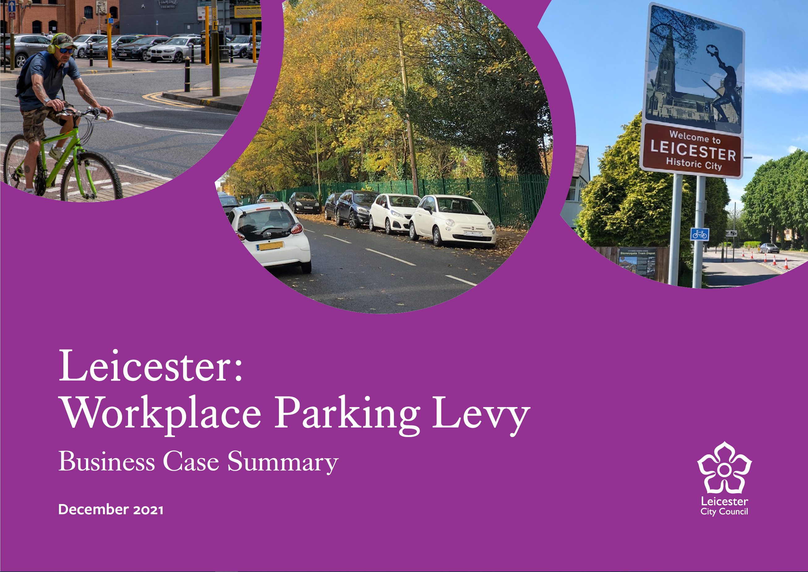

Leicester Workplace Parking Levy Consultation on Business Case

Slide 2
All WPL consultation documents available at https://consultations.leicester.gov.uk/sec/wpl/
Summary document
Employer FAQ's

Slide 3
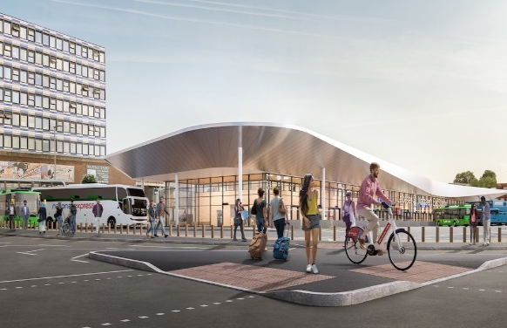
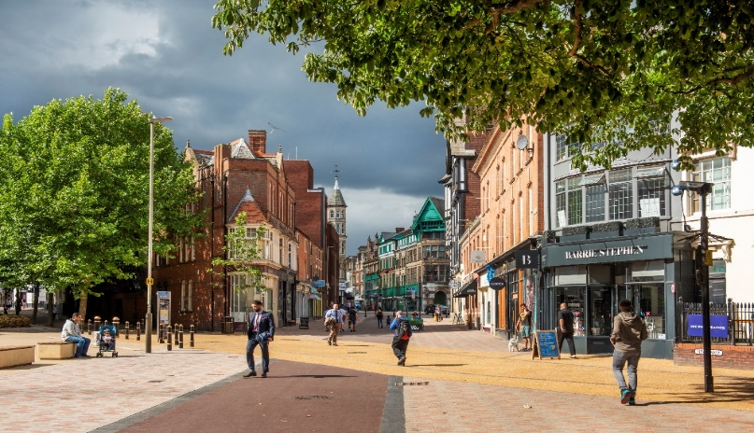
Overview
What is a WPL?
Why propose WPL for Leicester ?
WPL scheme details
What WPL will fund
Supporting employers & employees
Next Steps

Slide 4
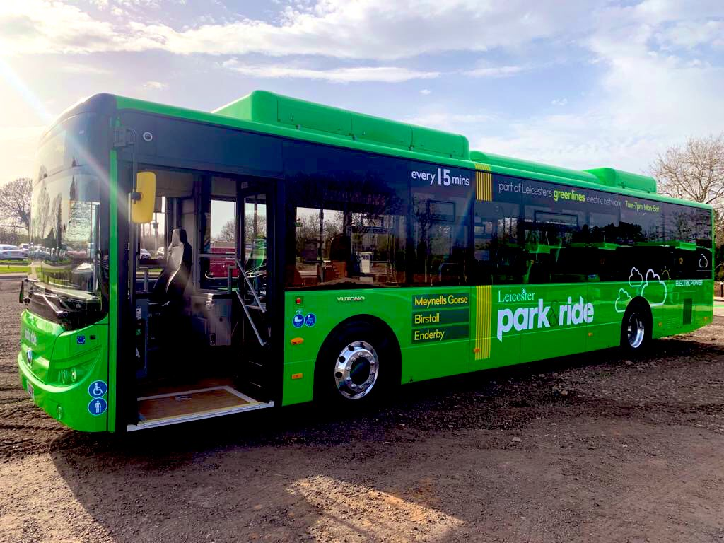
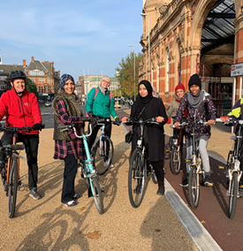
What is a WPL?
Purpose is to encourage car commuters to consider other modes of transport, and to provide consistent funding to deliver essential sustainable transport improvements
Charge on employers who provide liable workplace parking places for employees
Employers can choose if and how to pass the cost of WPL to their employees who use the spaces
Receipts must be spent on transport
LCC proposals follow the principles of successful Nottingham scheme-started in 2012
A number of LAs are now investigating WPL including Bristol, Oxford and London Boroughs

Slide 5



Why propose WPL for Leicester?
A Workplace Parking Levy would fund essential sustainable transport plans to help tackle our big city challenges and meet Government targets:
Climate Emergency
  Transport accounts for 25% of Leicester’s carbon emissions
  Net zero carbon by 2030 & 50% trips by walking/cycling
Congestion/City Growth
  Top 10 congested city – time & cost to business and commuters
  Over 60,000 additional homes planned in and around the city by 2036
  Would mean c60,000 more vehicles in peak periods
Health
  Tougher air pollution targets - impact on respiratory/heart disease – cost to NHS
  Third of Leicester residents are physically inactive – cycling and walking lowers the risk of developing cancer and heart disease - cost to NHS

Slide 6
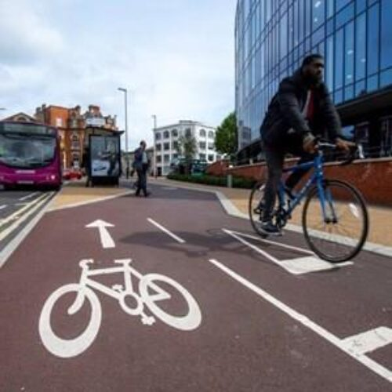
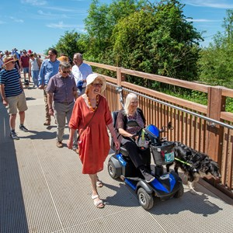
Proposed WPL Scheme Details
Closely mirrors Nottingham WPL scheme
Boundary: Leicester City Council administrative area
Charge to employer: £550 per chargeable place per year (employer decides if and how to pass onto staff)
Operation: 24 hours a day all year
Exemptions:
  Motorbikes / personal mobility vehicles
  Delivery vehicles/ visitors / customers
Discounts:
  100% discounts:
    Workplaces with 10 or fewer qualifying places
    Blue light emergency services
    Registered Blue Badge Holders
  NHS 50% discount for first 3 years

Slide 7
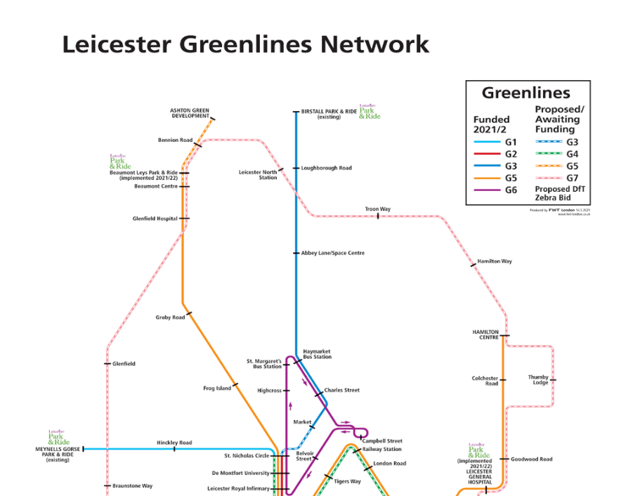
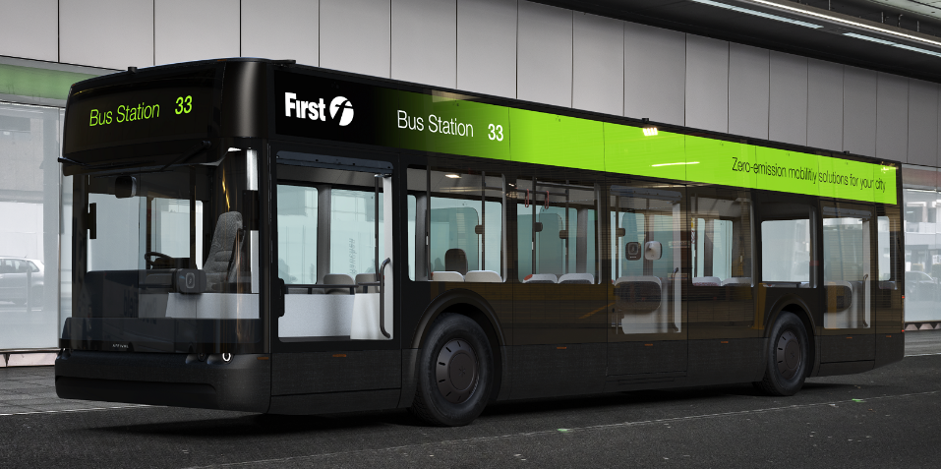
What WPL will fund
Potential WPL income is c£9m pa
With match funds = c£450m transport investment fund over 10 years
A ‘Bus Service Improvement Plan’ developed by the ‘Leicester Buses Partnership’ focussed on delivering high quality, reliable and affordable bus services across the city
Key proposals include:
  Over 400 high quality electric tram-like buses by 2030
  25 electric ‘Mainline’ services serving all city neighbourhoods
  Five electric ‘Greenline’ express commuter services including 3 cross city electric bus links to park and ride sites and 2 new electric orbital bus services (free city centre loop and outer ring road service)
  New commuter bus lanes to deliver reliable services at a good frequency
  Flexible ticketing across all main operators and ‘best fare’ for any journey travelled
  Quality waiting facilities with real time displays
  Discounted bus fares for elderly, disabled, unemployed and young persons

Slide 8
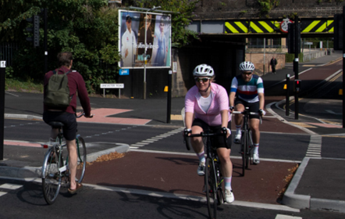
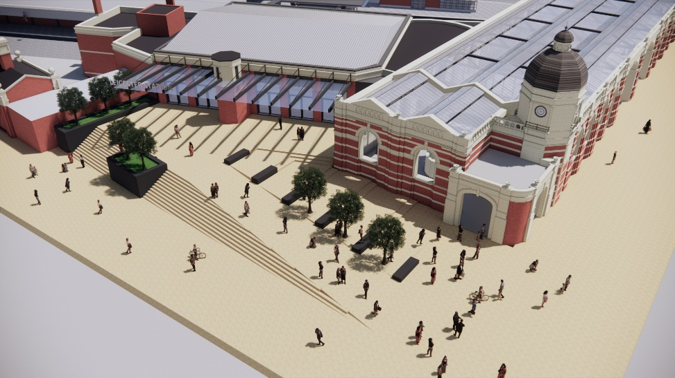
What WPL will fund
Potential WPL income is c£9m pa
With match funds = c£450m transport investment fund over 10 years
world class city-wide network of cycleways building on the high-quality segregated cycle and pedestrian routes in the city centre, with additional new routes linking to local neighbourhoods and employment areas across the whole city
Connected healthy neighbourhoods - safe attractive walking and cycling routes linking to local facilities, community hubs and schools – helping to deliver 15-minute neighbourhoods with cleaner air and more active people
Transforming Leicester Rail Station - building on the £22m secured for phase 1, future WPL funds for later phases to support new and improved inter-city services, for example to Coventry and Birmingham, and also to stimulate regeneration in the station area

Slide 9

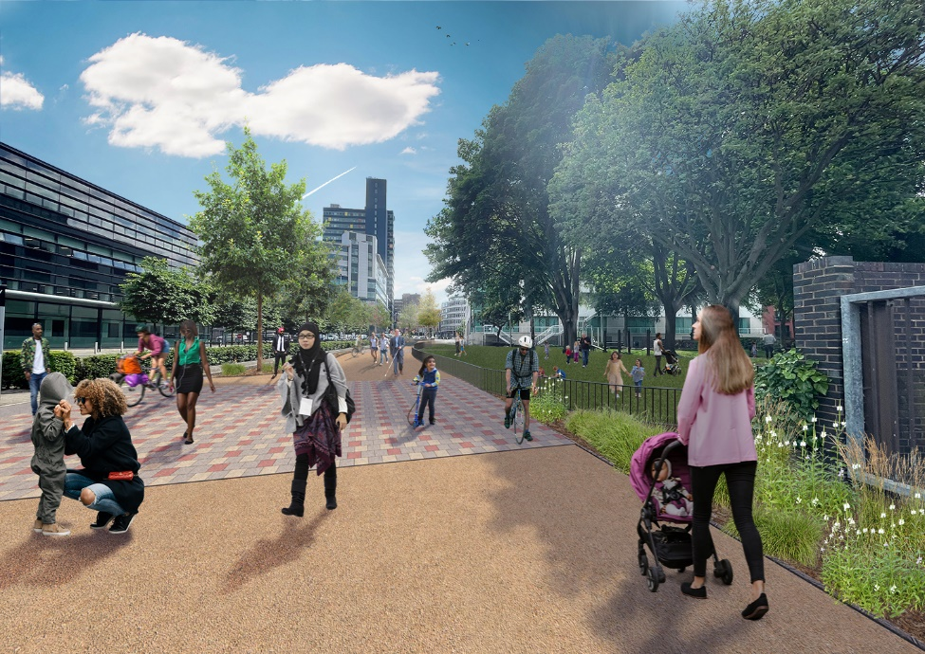
Supporting Employers and Employees
DMU study considered potential WPL impact on employers/employees e.g. charge level
Employers
100% small business discount (c90% businesses not liable)
Supporting employers outside of city centre - city wide bus/cycle/walk investment
Comprehensive business support package funded from WPL
– advice/guidance/benefits
Advice on fair charging for staff
Grants – cycle parking/showers
Employees
Better travel options for all employees (c40% no car)
Access to expanded multi operator bus network/frequencies/fares
Access to expanded cycle network – low cost travel
Personal travel planning
Public transport travel discounts
Less congested roads

Slide 10
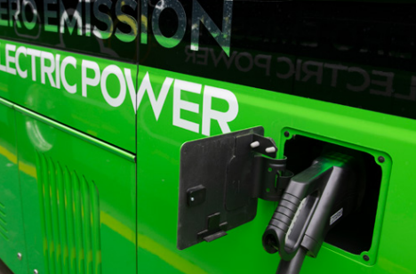
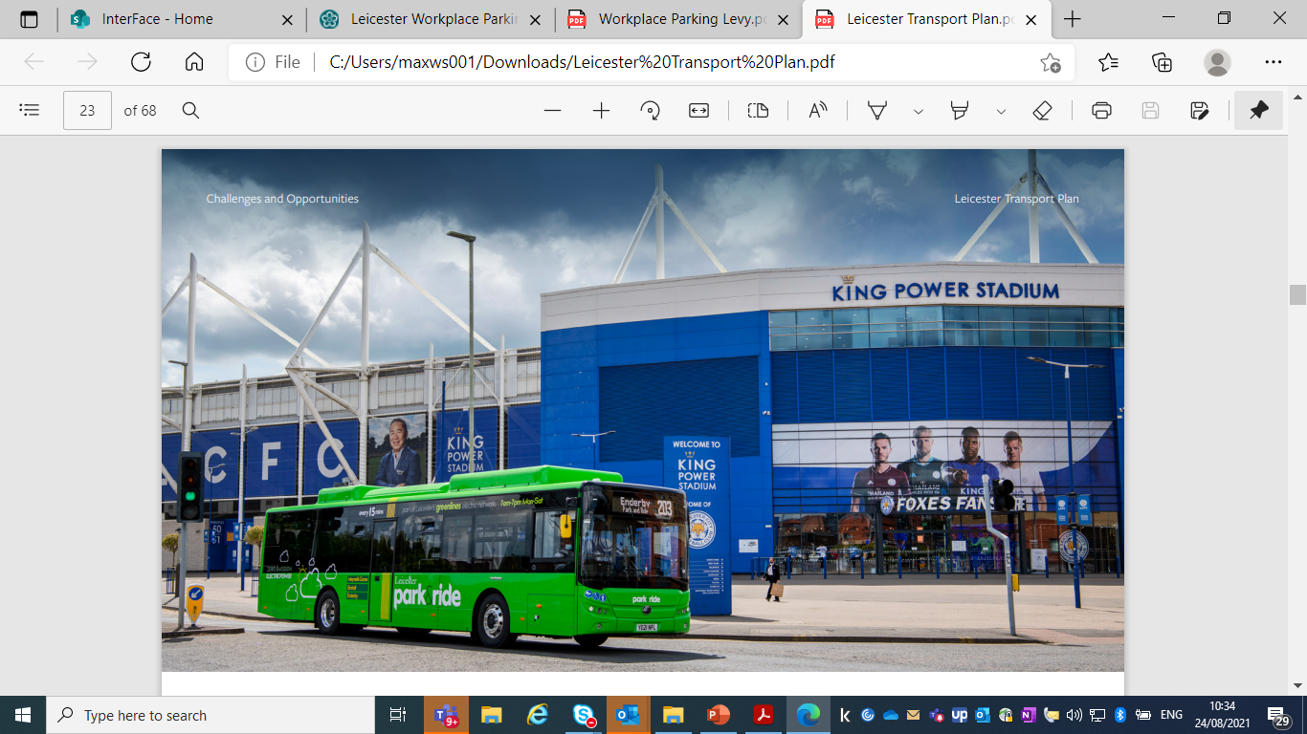
Next Steps
WPL consultation on business case/evidence concludes 13th March
Council considers consultation responses and next steps - spring 2022
Business case would ultimately require Secretary of State approval
Earliest introduction spring 2023

